Slide 1
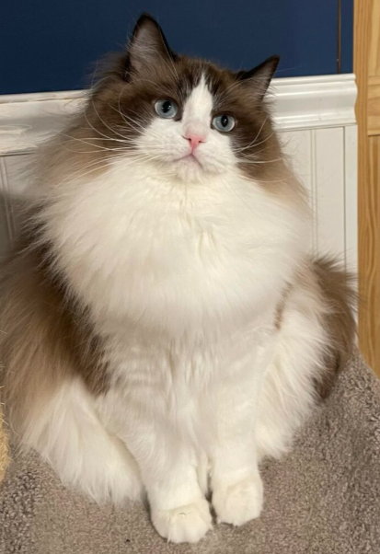
THE CHERUBIM BREED
CREATED BY ANN BAKER
Photo credits: Chanan, Olek Kuperberg, Larry Johnson, Audra Mitchell, Helmi
Thank you to the following catteries contributing photos of their beautiful Ragdolls and Cherubim Felines and for showing their cats to aid in obtaining the recognition that they have always deserved:
:
Christine Lupo Jayne Harmon Nicole Shambach Sandy Roberts
Elvia Leclair Rovena Parmley Susanne Buchel Macanka Jamie Lennox
Amanda Nicodemus Micayla Ash Laure Nvf Anna Hinson
Seanna Grochowski Aleksandra Buras Agnes Vijfschaft Rintha Smith
Lynne Rotas Falls Kelly Schockman Margareta Helleman Vlada Astral
Dekoel Smth Sherry Bolt Meghan Palensky Lisa Fleming
Heather Ellis Val Lhocoi du Gival MirJam Pettersson

Slide 2
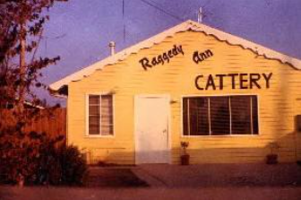
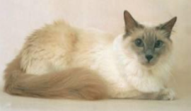
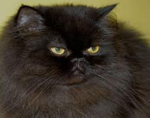
HISTORY OF THE CHERUBIM: RAGGEDY ANN CATTERY
The Ragdoll breed was first created by a woman, Ann Baker, who
was breeding Black Persians and worked with Apple-headed Lilac
Balinese cats in Riverside, California in the 1960s. The name of
her cattery was Raggedy Ann. Ann Baker's client entrance was
attached to her home. The story of the mother of all Ragdolls is
interesting and includes both the famous first cat, Josephine, and
her breeder, Ann Baker. Her Ragdoll cats were bred from pre-existing
breeds and as the years went by the traits that were more desirable were kept, and the undesirable traits were bred out of the lines. The results were large, exquisite Ragdoll Cats with serene dispositions in solid, mink, sepia, and pointed colors.
You can see beautiful Ragdolls and their breed group of Cherubims at TICA cat shows in your local area.

Slide 3
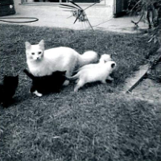
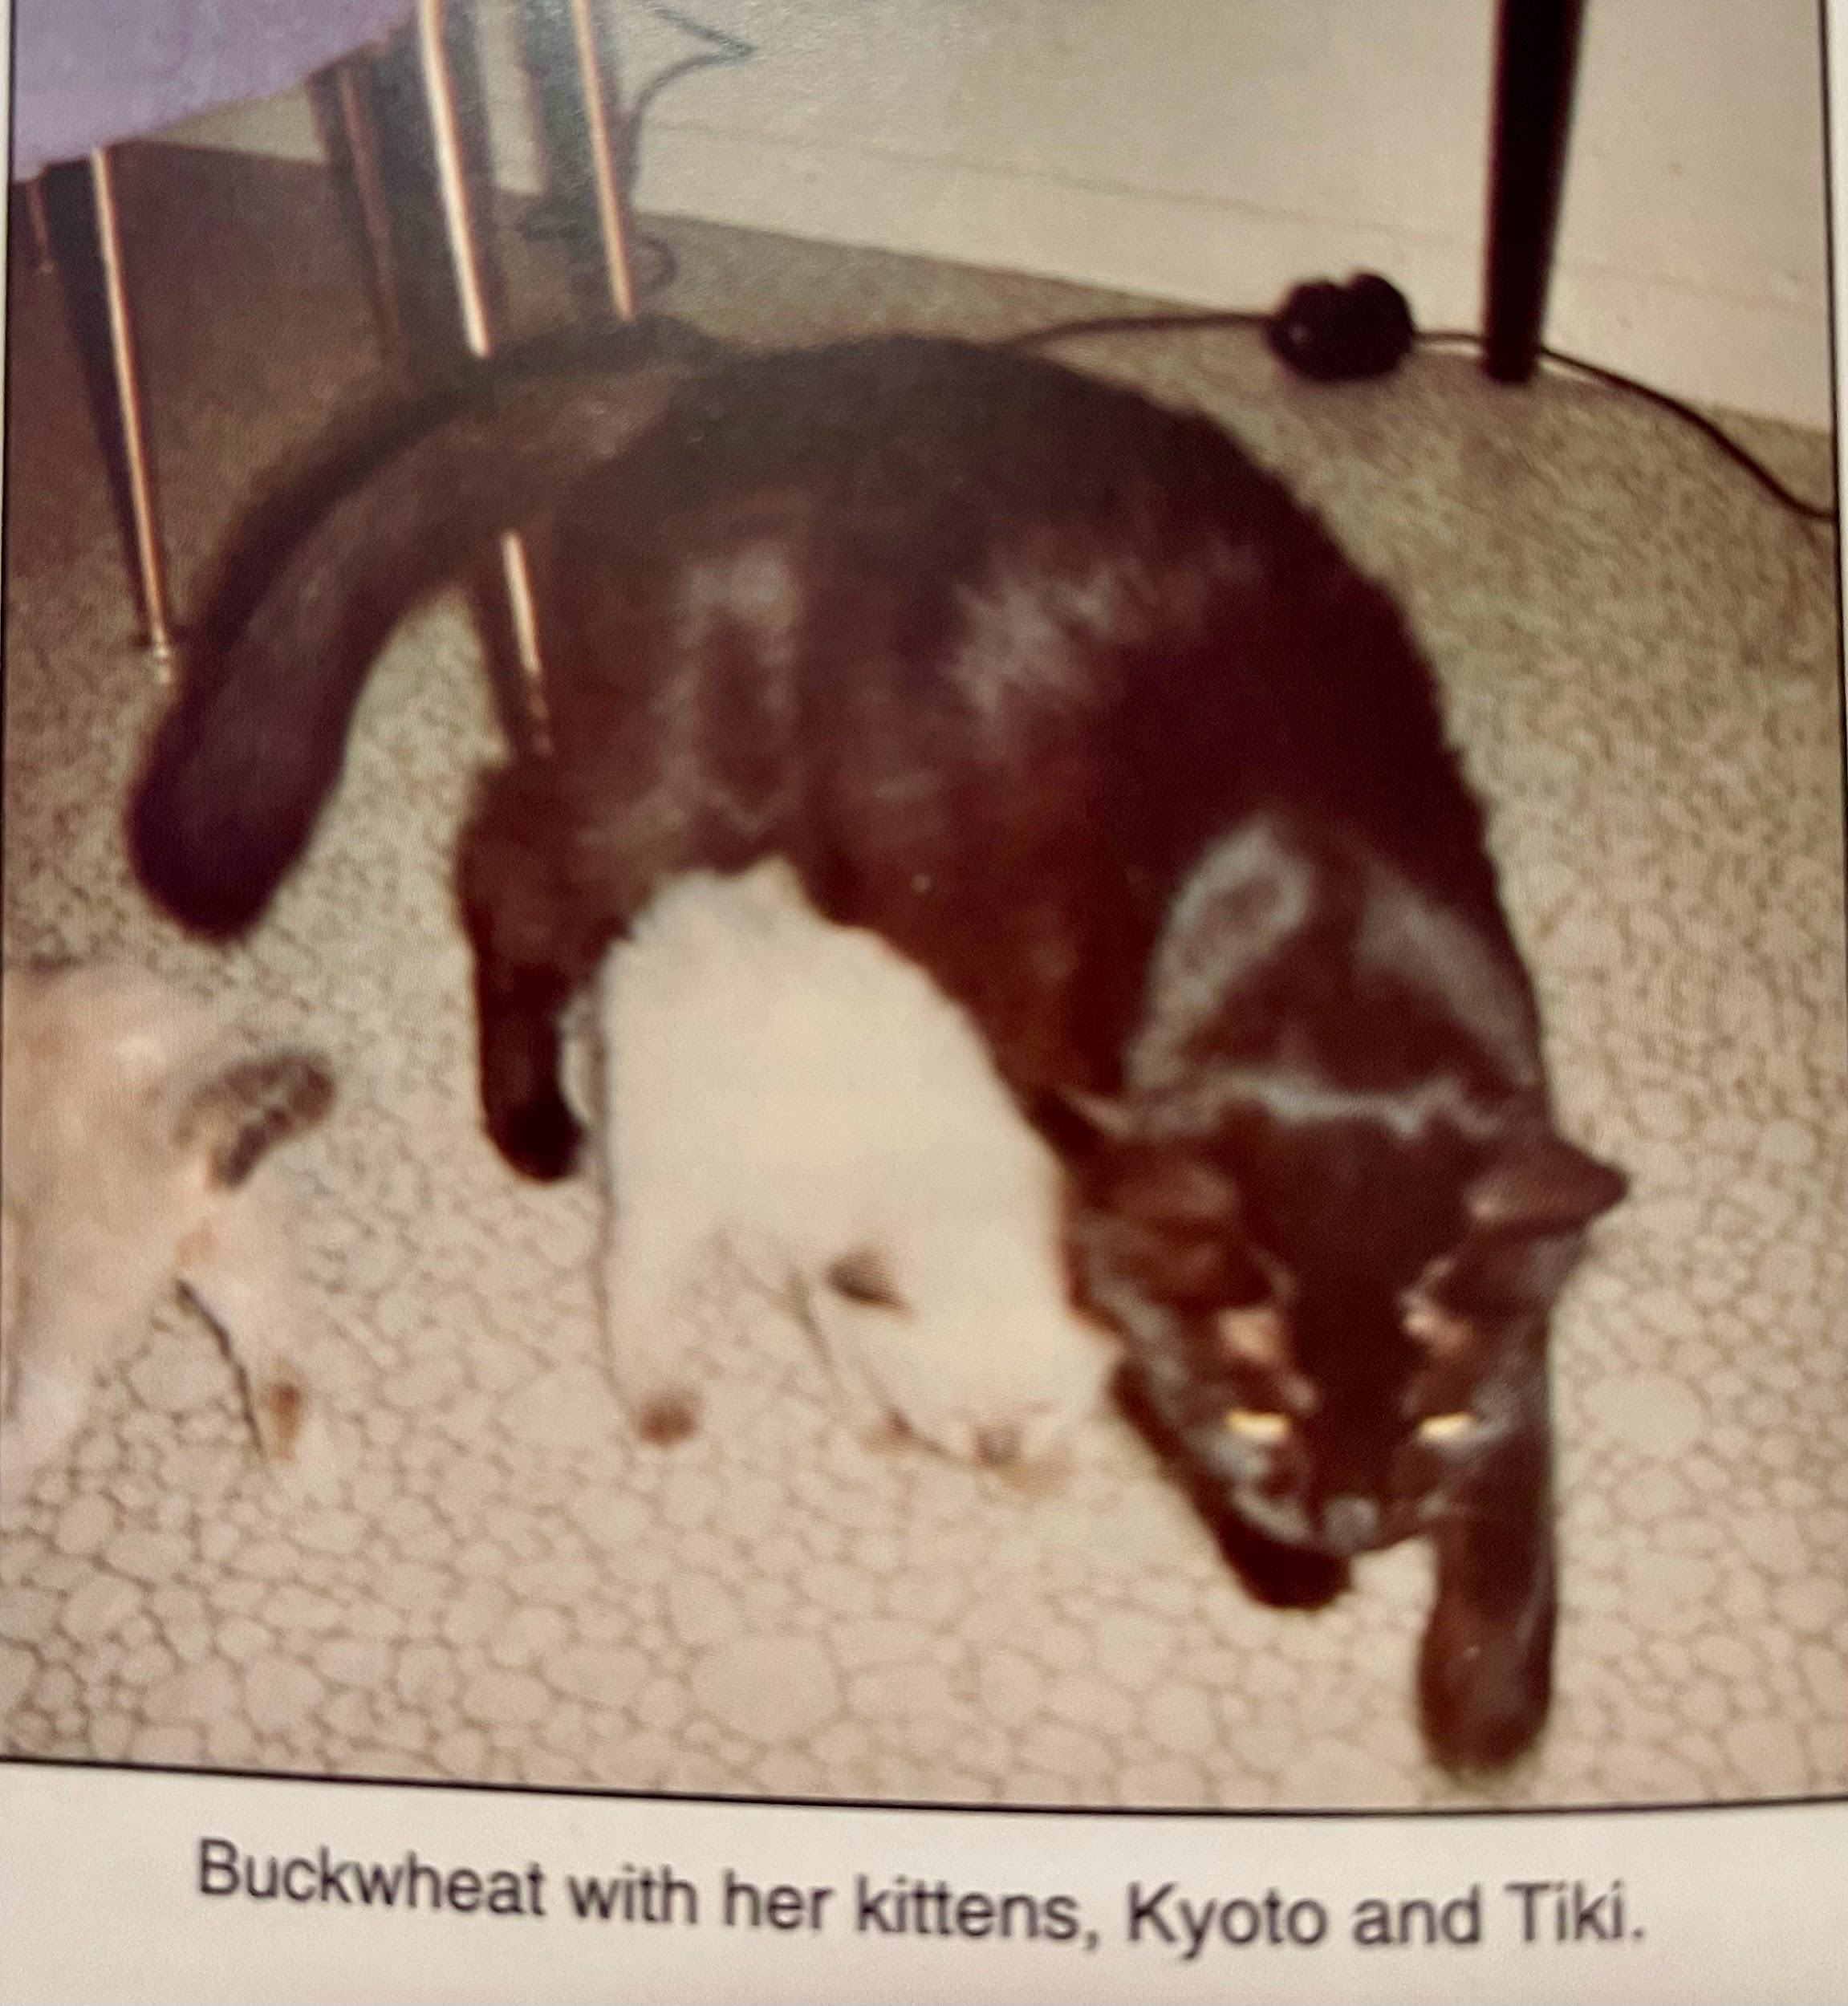
THREE Ancestral Felines
❖ According to The Association of the Original Ragdoll (VdOR), Ann Baker, the pioneer and ORIGINATOR of the Ragdoll breed, utilized the first genealogical mother, a pure white cat and founder of the “White Line,” Josephine. The second genealogical mother, Burmese (BLACKIE in some databases and at times incorrectly designated as a male) was the founder of the “Dark Line,” whose markings were MINK and carried the variant point gene. The photo (right) depicts Burmese with her kittens, the kitten on the right in the photo is thought to be Buckwheat, a Seal Colorpoint, according to the Dayton Genetics Card. The third ancestral animal and genealogical father is Birman (BEAUTY in some databases) who looked similar to the breed Sacred Burma who carried the white spotting gene, not the laced Glove gene (bicolor would not have been possible). All three are of UNKNOWN origin.

Slide 4
HISTORY:
For 100% Original Ragdolls, based upon this information, the following is true as per the VdOR Database:
“100% Original Ragdoll lines traceable to Ann Baker’s 3 Original ancestral cats: Josephine (Mother [Dam]of all Ragdolls), Blackie (Burmese [Dam] in Dayton Genetics Card), and Beauty (Birman [Sire] In Dayton Genetics Card).”
JOSEPHINE was a solid carrying the pointed gene.
BURMESE (called Blackie in some databases) was a Mink female.
BIRMAN ( called Beauty in some databases) could have been either MINK or a pointed male.
If all three ancestral cats are truly of unknown parentage, then the three Original ancestral cats were solid, mink, and EITHER a pointed or a mink.
Based upon genetics alone, Daddy Warbucks could have been a blue eyed chocolate mink; likewise, for Buckwheat, the daughter of the dam, Burmese (Blackie). Baker’s Light/Dark line theory was based upon appearance and temperament. The ideal Ragdoll, according to Baker, was a combination of the two lines to maintain balance in type. In addition to this, it can be surmised that Baker knew exactly what she was doing in creating a dark line and a light line: minks on the dark line were intentional by breeding the cats, Burmese x Daddy Warbucks. Chocolate and Lilac minks appear white at birth; Blue eyed Chocolate and Lilac Minks look like pointed Seal and Blue adults. Baker worked closely with Blue Mountain and (intentionally or not based upon genetics) kept those mink and pointed genes going through that Cattery that remained loyal to Baker, along with the catteries of Purple Heather, Vistin, JD’s, Rway, and Monty.

Slide 5
FIVE Founding Ragdolls
❖ Rollins states, “1) DADDY WARBUCKS in Seal Mitted and 2) GUEBER in Seal Mitted… are brothers from the mating of Josephine x Birman [Beauty]”(36).
Gueber. Was he solid or pointed? Again, Rollins states the five founding Ragdolls descended from three ancestral cats: Josephine, Burmese, and Birman (33).
According the book, Original Ragdoll Genuine and Authentic, the photo of Josephine with her four kittens are of “Two solid black ones, which she did not use for breeding, and the two [pointed] males Daddy Warbucks and Gueber” (Rollins 34).
According to Baker’s ledger, a litter of four out of Buckwheat x Daddy Warbucks born on July 3, 1965, named Tiki, Kyoto (NCFA reg), plus separated out were Gueber and Mitts labeled as “experimental Persians.”
Pickering and his co-authors of The Definitive Guide to Ragdolls captioned the photo, “Stand in for Josephine with the first Ragdoll kittens, Summer 1965. Left to right, Gueber, Mitts, Tiki, and Kyoto” (2). Pickering also states, “During detailed questioning [of 77 year old Baker], Ann confirmed that…he [Daddy Warbucks] was the only kitten in that particular litter of Josephine’s” (3).
In Baker’s book, IRCA and the Ragdoll Documentary, it depicts the same photo as The Definitive Guide to Ragdolls, but captioned, “Stand in for Josephine, the mother who was injured in an accident.” (6). She references it later indicating, “They are originally brother and sister to Tiki and Kyoto” (Breeding Program 8). Were the pointed kittens in the photo Tiki/Kyoto born in 1965, or Warbucks/Gueber circa 1963?
Dayton’s pedigree of Raggedy Ann Buddy, extract from VdOR, indicates that Tiki and Kyoto are out of Daddy Warbucks x Buckwheat.

Slide 6
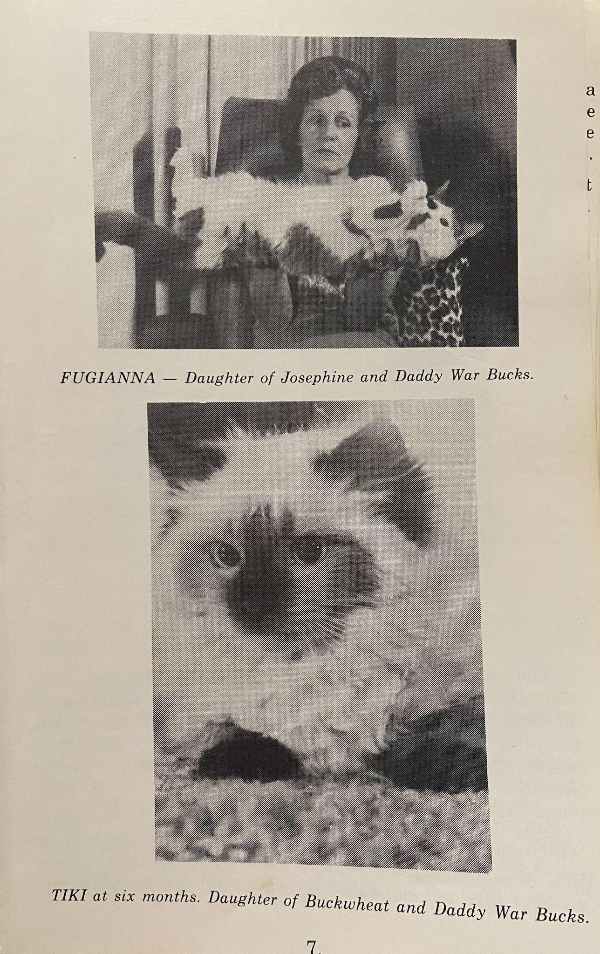
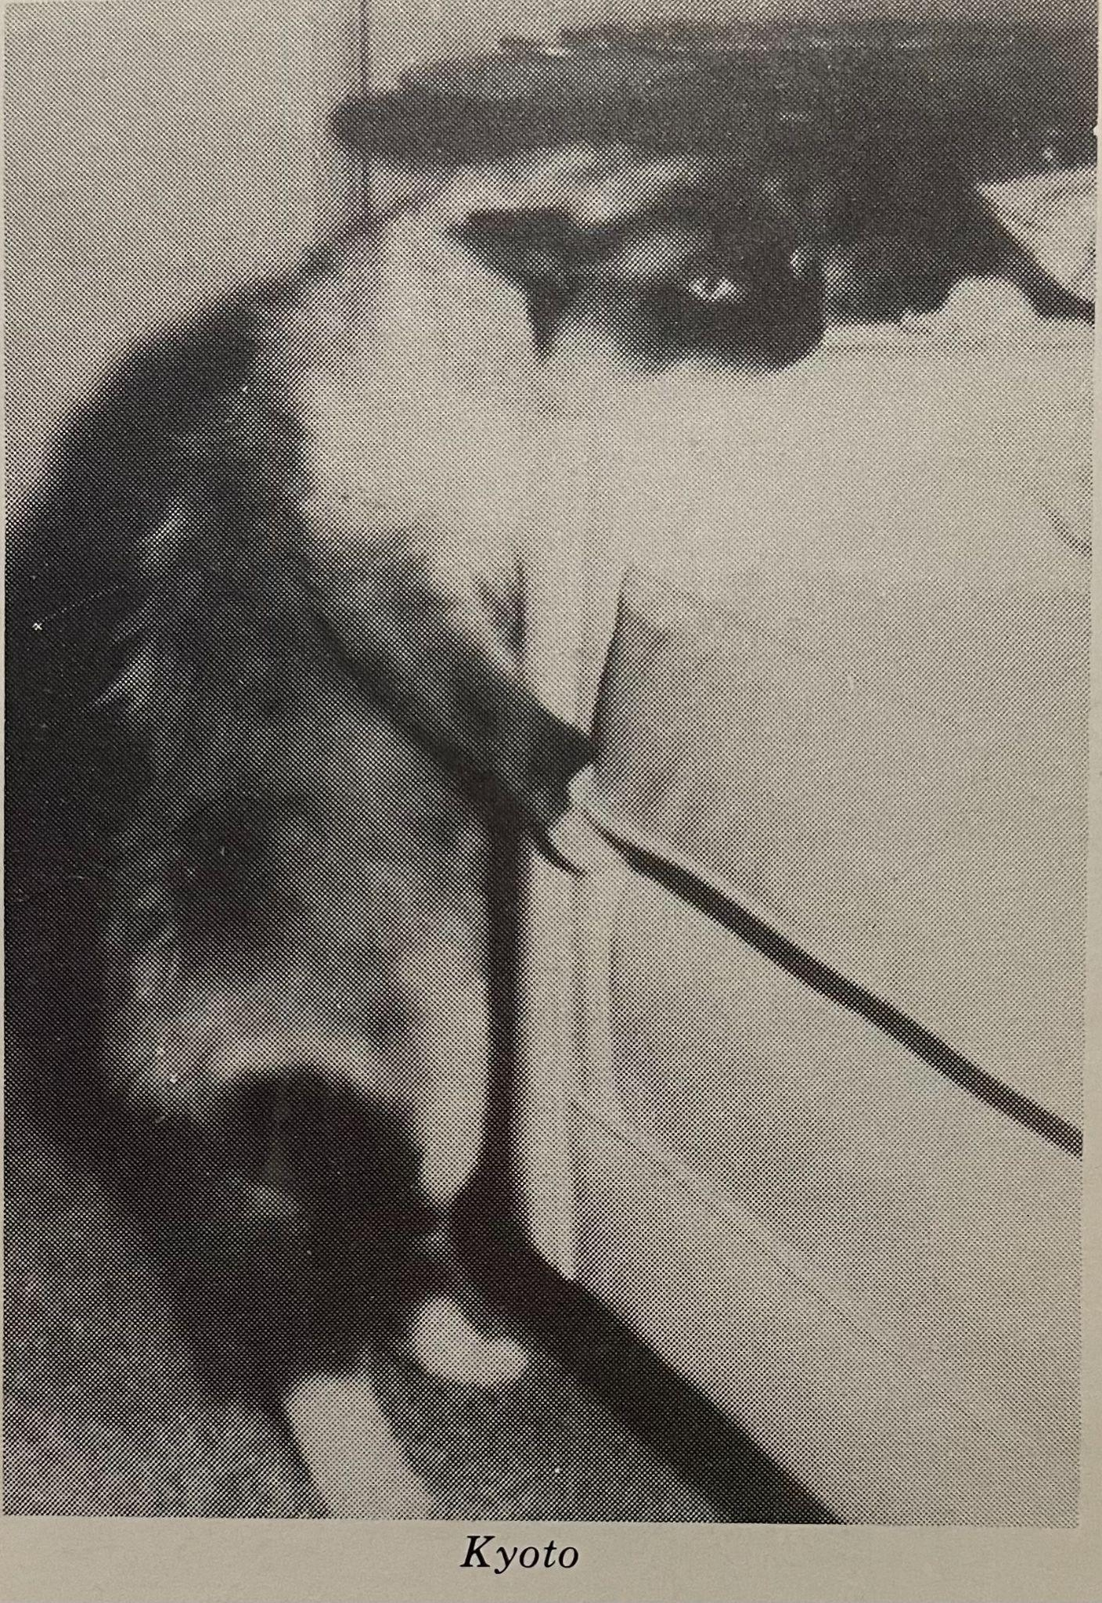
FIVE Founding Ragdolls
❖ 3) Fugiana in Seal Bicolor from the back mating of Josephine with her son, Daddy Warbucks.
❖ 4) Tiki in Seal Colorpoint and 5) Kyoto in Seal mitted. These two siblings are born out of Buckwheat and Daddy Warbucks.

Slide 7
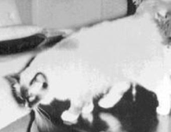
❖ The Lightline (LL) was from Josephine. In 1963, Baker mated Josephine x Birman that produced the founding cats: Daddy Warbucks and Gueber in Seal Mitted, and the back mating: Josephine x Daddy Warbucks that produced the third founding cat in 1965: Fugianna, Seal Bicolor.
❖ The Darkline (DL) was from Burmese (Blackie). In 1965,
Baker bred Burmese x Daddy Warbucks that produced Buckwheat in Seal Colorpoint (according to Dayton Genetics Card). From the back mating of Buckwheat x Daddy Warbucks came Tiki, seal colorpoint and Kyoto, an extremely dark Seal Mitted.

Slide 8
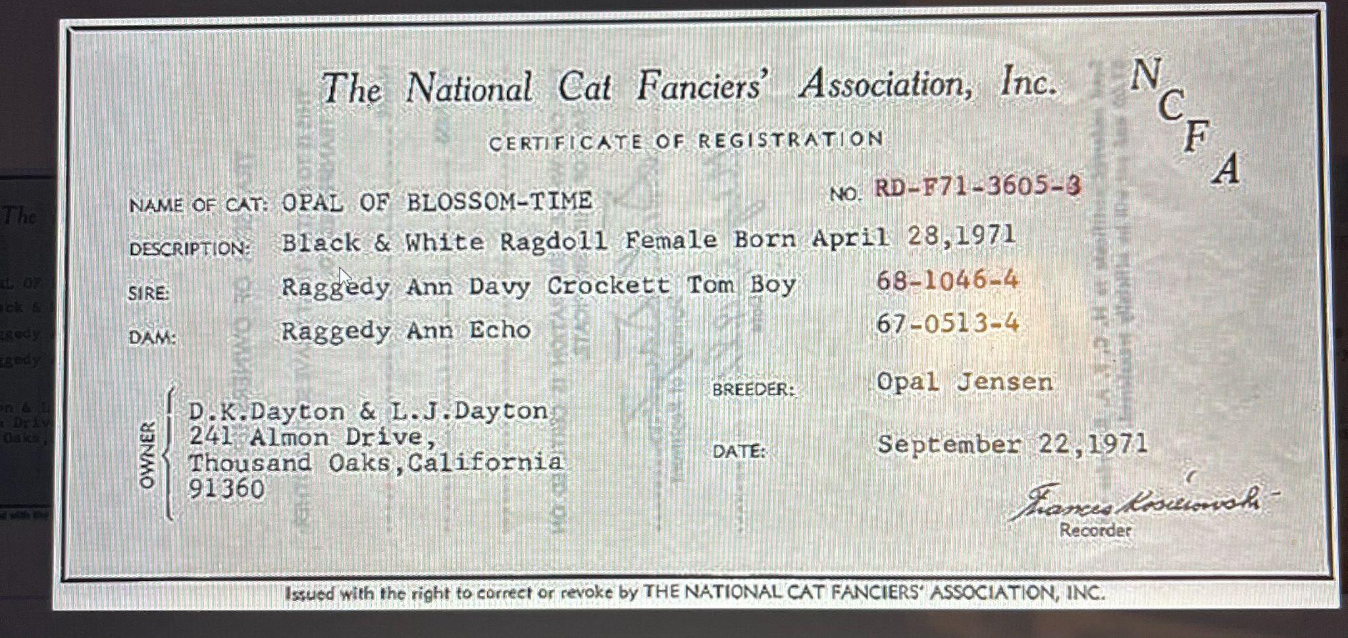
Catteries Loyal to Ann Baker
To reiterate, Baker worked closely with Blue Mountain and possibly (intentionally or not based upon genetics) kept those mink and pointed genes going through that Cattery, who remained loyal and honored Baker’s contract, along with Purple Heather, Vistin, JD’s, Rway, and possibly Monty.
Purple Heather and Blue Mountain cats are included in the Dayton Genetic Card called the “Sideline” based upon what he “knew” of the parentage. Many have “unknown” in their pedigrees because those cats are from those catteries. VdOR, Tina Rollins, tried to correct RFCI and PawPeds Databases. In Tina Rollins’ book, she expresses frustration at the lack of interest in making corrections. Many Ragdoll breeders certainly have experienced this with PawPeds and can corroborate her statements.
Pointed, Solid, and Mink Ragdolls have been in existence since the inception of the breed and registered with both IRCA and TICA.

Slide 9
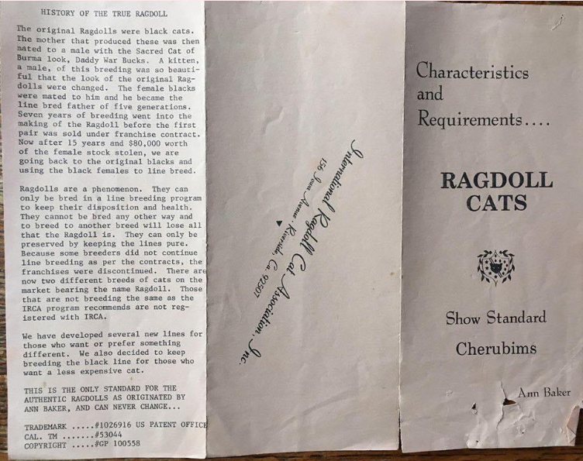
Ann Baker’s IRCA Cherubim Breed Standard

Slide 10
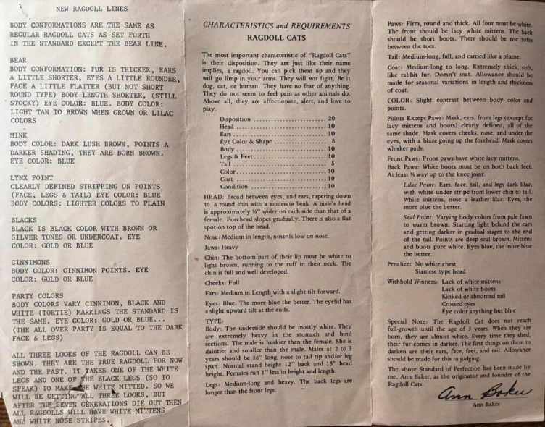
Ann Baker’s IRCA Cherubim Breed Standard

Slide 11
Excerpt from:
Breeding Program for the IRCA Registered Authentic Ragdolls
by Ann Baker
“Now we go back to the Ragdoll Tus…they are black and white but brother and sister to the original Sacred Cat of Burma look…we used these the past 15 years to experiment to know all the pros and cons of the Ragdolls…now we can breed and we get black & white, gray & white or black or we can even get the brown or Himalayan & Sacred Cat of Burma coloring, etc…the blue-eyed and seal point or lilac we can call Ragdolls and the blacks and gold eyes are Ragdoll Tus…these really make for deeper blue eyes is the greatest asset…especially if your Ragdolls are getting too light eyes…too light eyes means overbred…and/or too much lilac line…” (5).

Slide 12
❖ Matings of the three Dams:
Josephine x Birman (Beauty) = Daddy Warbucks and Gueber.
Josephine x Daddy Warbucks = Fugianna
Burmese x Daddy Warbucks = Buckwheat
Buckwheat x Daddy Warbucks = Tiki and Kyoto
❖ Lightline (LL) /Darkline (DL) and the first Ragdoll
founding cats:
Raggedy Ann Daddy Warbucks, Seal Mitted (LL)
Raggedy Ann Gueber, Seal Mitted (LL)
Raggedy Ann Fugianna, Seal Bicolor (LL) DOB: 5/5/65
Raggedy Ann Kyoto, Seal Mitted (DL) DOB: 7/3/65
Raggedy Ann Tiki, Seal Colorpoint (DL) DOB: 7/3/65

Slide 13
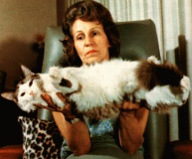
❖ Baker was ahead of her time.
Baker created her own breed standard, set up
franchisees with breeder sets, and established her
own Ragdoll organization, the International
Ragdoll Cat Association (IRCA). She also patented
her Ragdoll name and colors. She was educated. She was forward thinking in regard to her interest in DNA, feline nutrition, and natural remedies. She was a business woman, when most women were relegated to the home and dependent upon a husband in the 1960s. She, alone, was the creator, pioneer, and Originator of the Woman-made Breed, her breed: the Ragdoll.
Unfortunately, she was forced to protect herself and her beloved Ragdolls through contracts, patents, and the courts, when some breeders chose to oppose her in a variety of ways.

Slide 14
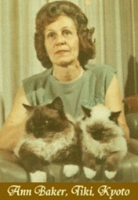
❖ Denny and Laura Dayton, who were among the first breeders to
purchase Ragdolls along with a few other breeders,
dismissed Ann Baker's vision of her Ragdoll and made it their
mission to establish a small representation of the Ragdoll breed (the blue-eyed variant) in multiple cat
fancier associations and show halls in the 70s and 80s.
❖ Yet another group of breeders, in the early 90s, who
purchased cats from Ann Baker, chose not to honor contractual agreements with Baker and decided to outcross to
other cats in order to produce different colors and patterns.
This group took the remnants of what the Daytons left
behind, in regard to Baker's Ragdolls, and promoted them as
a "new" breed: the Ragamuffin.
Ann Baker holding Kyoto and his SON, Kookie Tu.

Slide 15
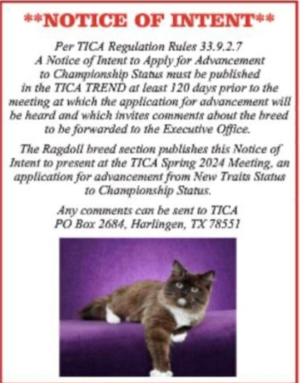
Application to Advance to
Championship Status!
Mink, Sepia, and Solid Ragdolls have been registered in TICA since 1979, but could only be shown in TICA within the “New Traits” (NT) class. On October 17, 2023, the notice of intent was published in the TICA Trend magazine as the first step taken to apply for advancement to Championship status as Cherubim through the creation of a breed group. In the three years prior to this date, there were finally enough NT cats showing to move forward with the proposal for advancement. This intent was submitted as per TICA rules which required it to be published a minimum of 120 days prior to the Board of Directors meeting, at which time the application would be heard

Slide 16
The Process from Survey
to Official Vote!
On November 5, 2023 an “unofficial” survey was sent to the breed section to permit all voices to be heard in regard to the name of the breed group. The choices were as follows: Cherubim, Cherubim Ragdoll, or Cherubim Doll. On November 6, 2023, the proposal was completed by Christine Lupo, Amanda Jimmink, and Elizabeth Boatwright with the breed group name still to be determined. Breeders of pointed, solid, mink, and sepia Ragdolls (there were five Blue Eyed Pointed breeders and five breeders representing the soon to be Cherubim) that collaborated on revising and finalizing the proposal that went through dozens of revisions, among ourselves, whittling it down from six pages to one. Upon determining the name and ability to pass an official vote, the proposal and application was completed and signed by all ten breeders and submitted to the appropriate committees.

Slide 17
CHERUBIMS ACCEPTED FOR SHOW IN THE USA!
On February 26, 2024, the Rules and Genetics Committees provided their input and suggested changes for the proposal, of which was completed post haste. On April 21, 2024, the official New Traits Advancement Poll closed. The TICA Ragdoll breed section voted FOR the breed group of Cherubim (CB) to be incorporated into the Ragdoll Breed Standard and on May 1, 2024 it was determined that 52.35% voting members supported the initiative. On May 19, 2024, the TICA Board of Directors voted UNANIMOUSLY to pass the Advancement of New Traits as a Ragdoll and Cherubim Breed Group. Cherubim will be required to complete the new breed annual reports for three years. Solid, Mink, and Sepia Ragdolls will be eligible to compete for CHAMPIONSHIP in TICA as Cherubim beginning May 1, 2025!

Slide 18
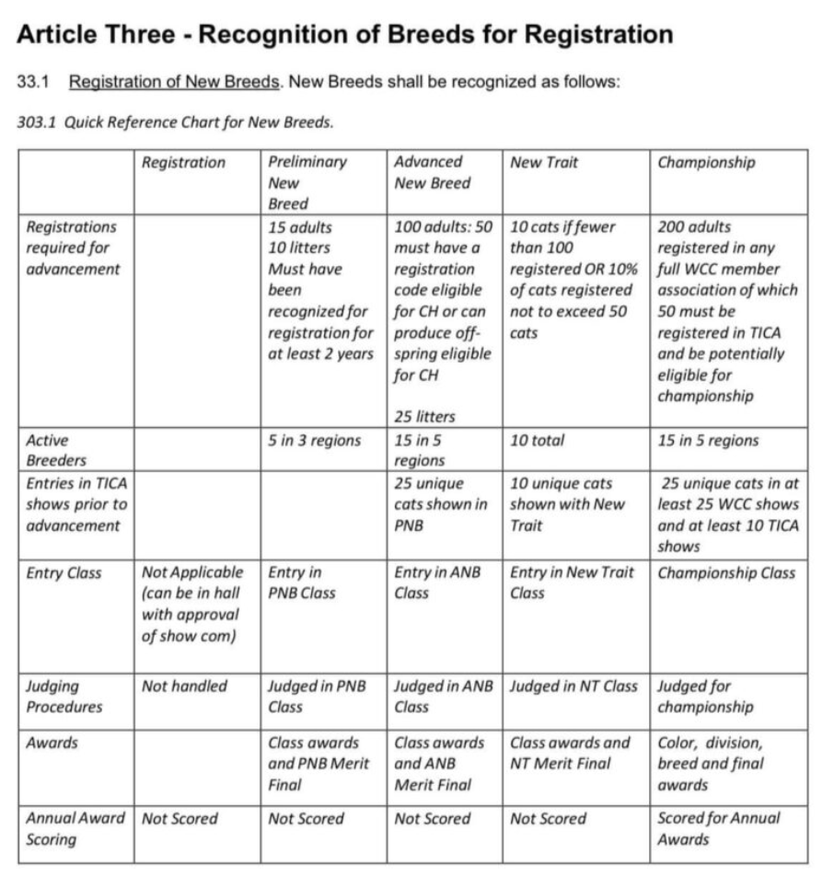
CHERUBIMS SHOWING IN THE CHAMPIONSHIP CLASS!

Slide 19
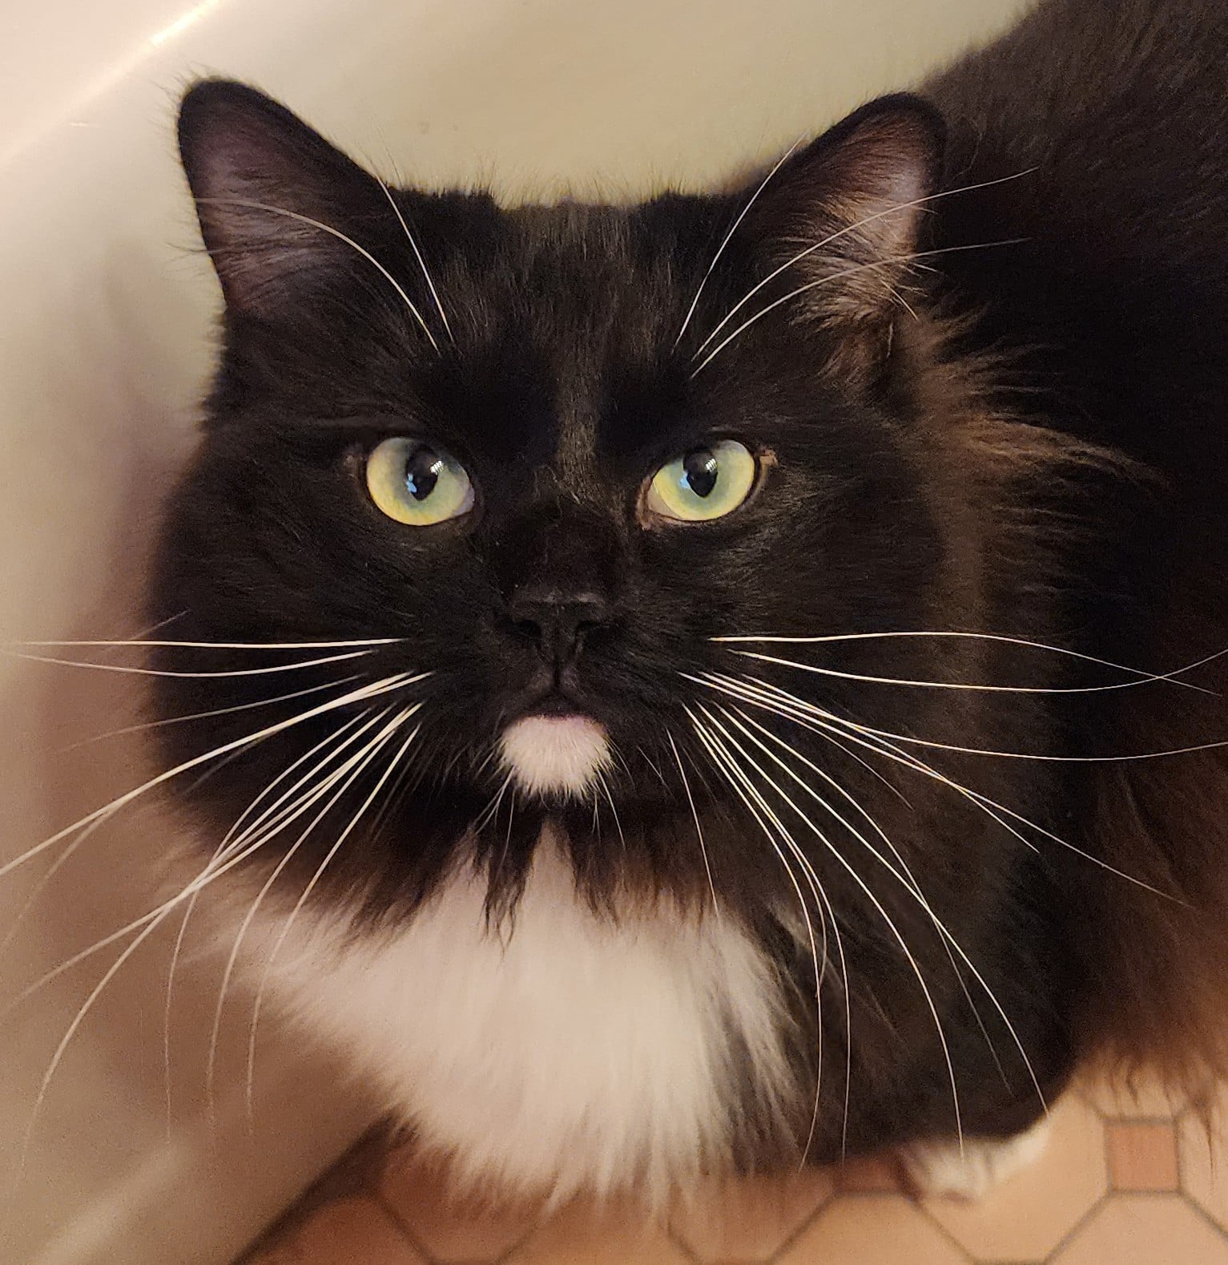
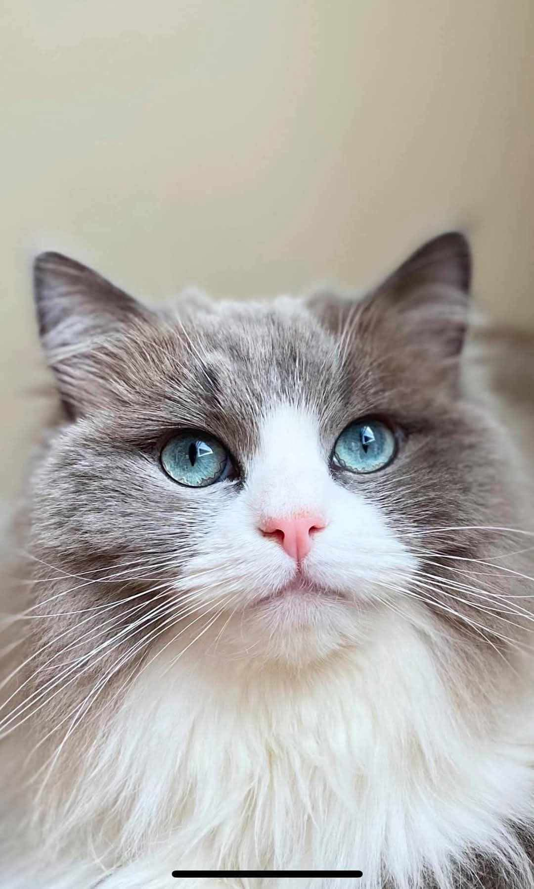
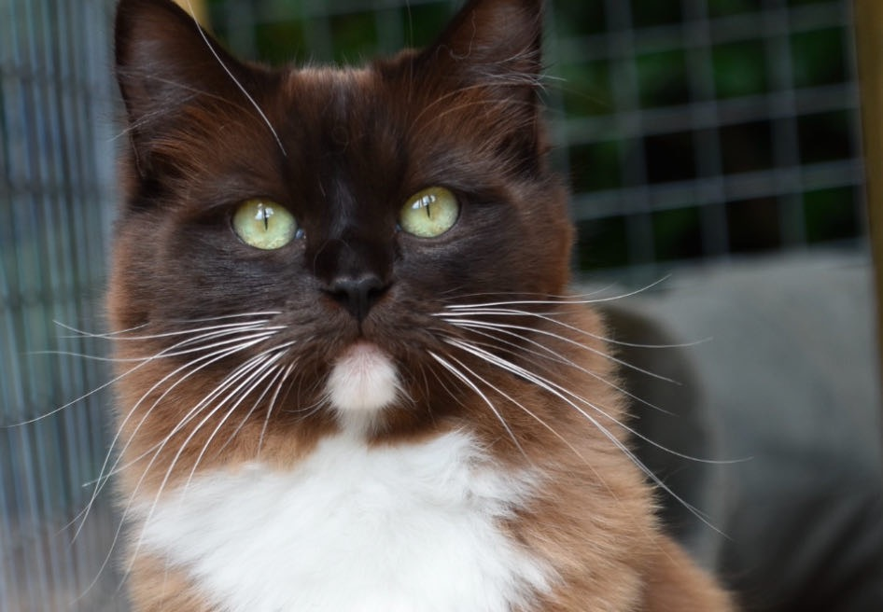
CHERUBIM Description
❖ An intelligent, large semi-long haired mink, sepia, or
Traditional (solid) colored cat of moderate type with a
sweet temperament .
❖ May take up to four years to grow large and
heavy, as it is slow to mature and may not reach full weight
and size until that time; furthermore, Cherubim are muscular,
but tend to have a lower abdominal fatty pad.
❖ Their coat colors consist of Seal, Blue, Chocolate, Lilac,
Cinnamon, Fawn, Red, Cream, and Tortie in the Solid,
Bicolor, and Mitted patterns. Full color is not reached until 3
years of age. They can be Mink, Sepia, or Solid in
Tortie, Torbie, or overlying Lynx, also known as tabby, patterns.

Slide 20
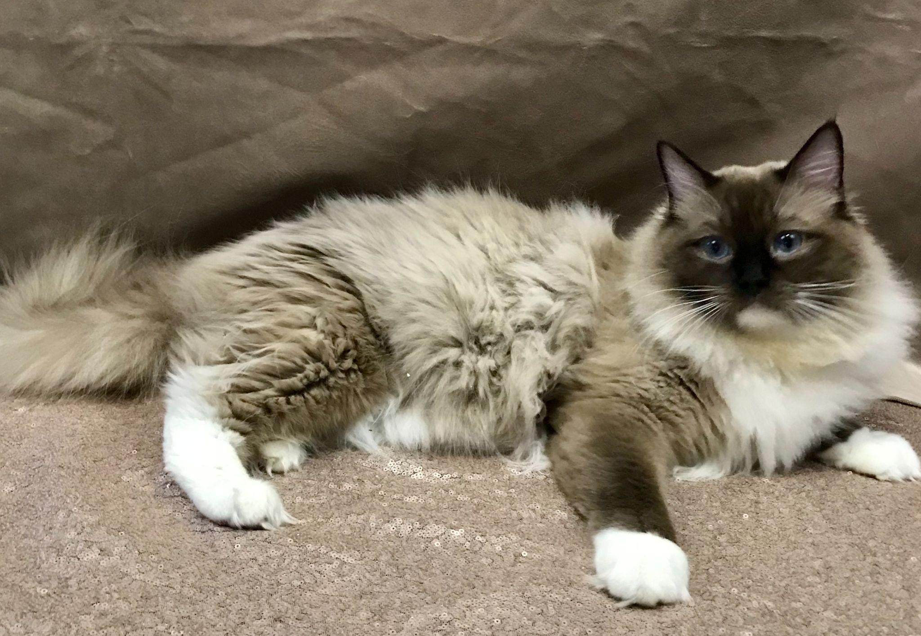
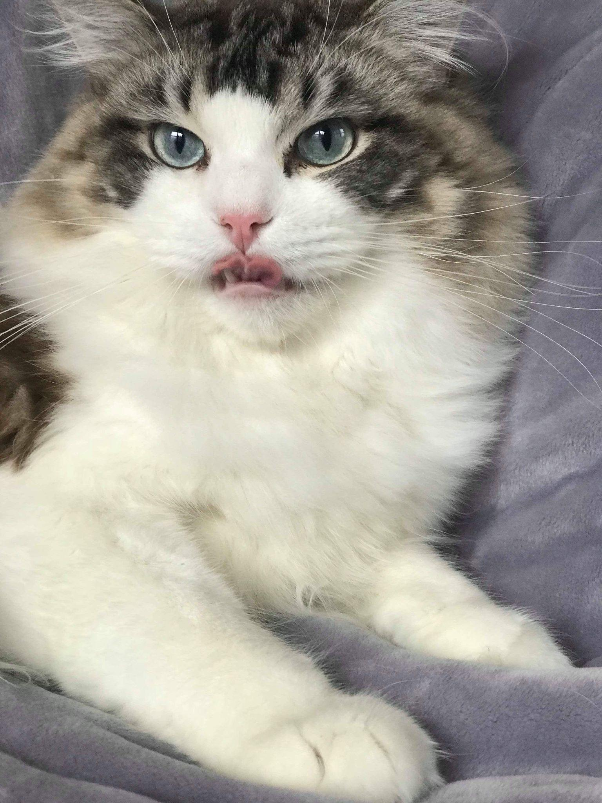
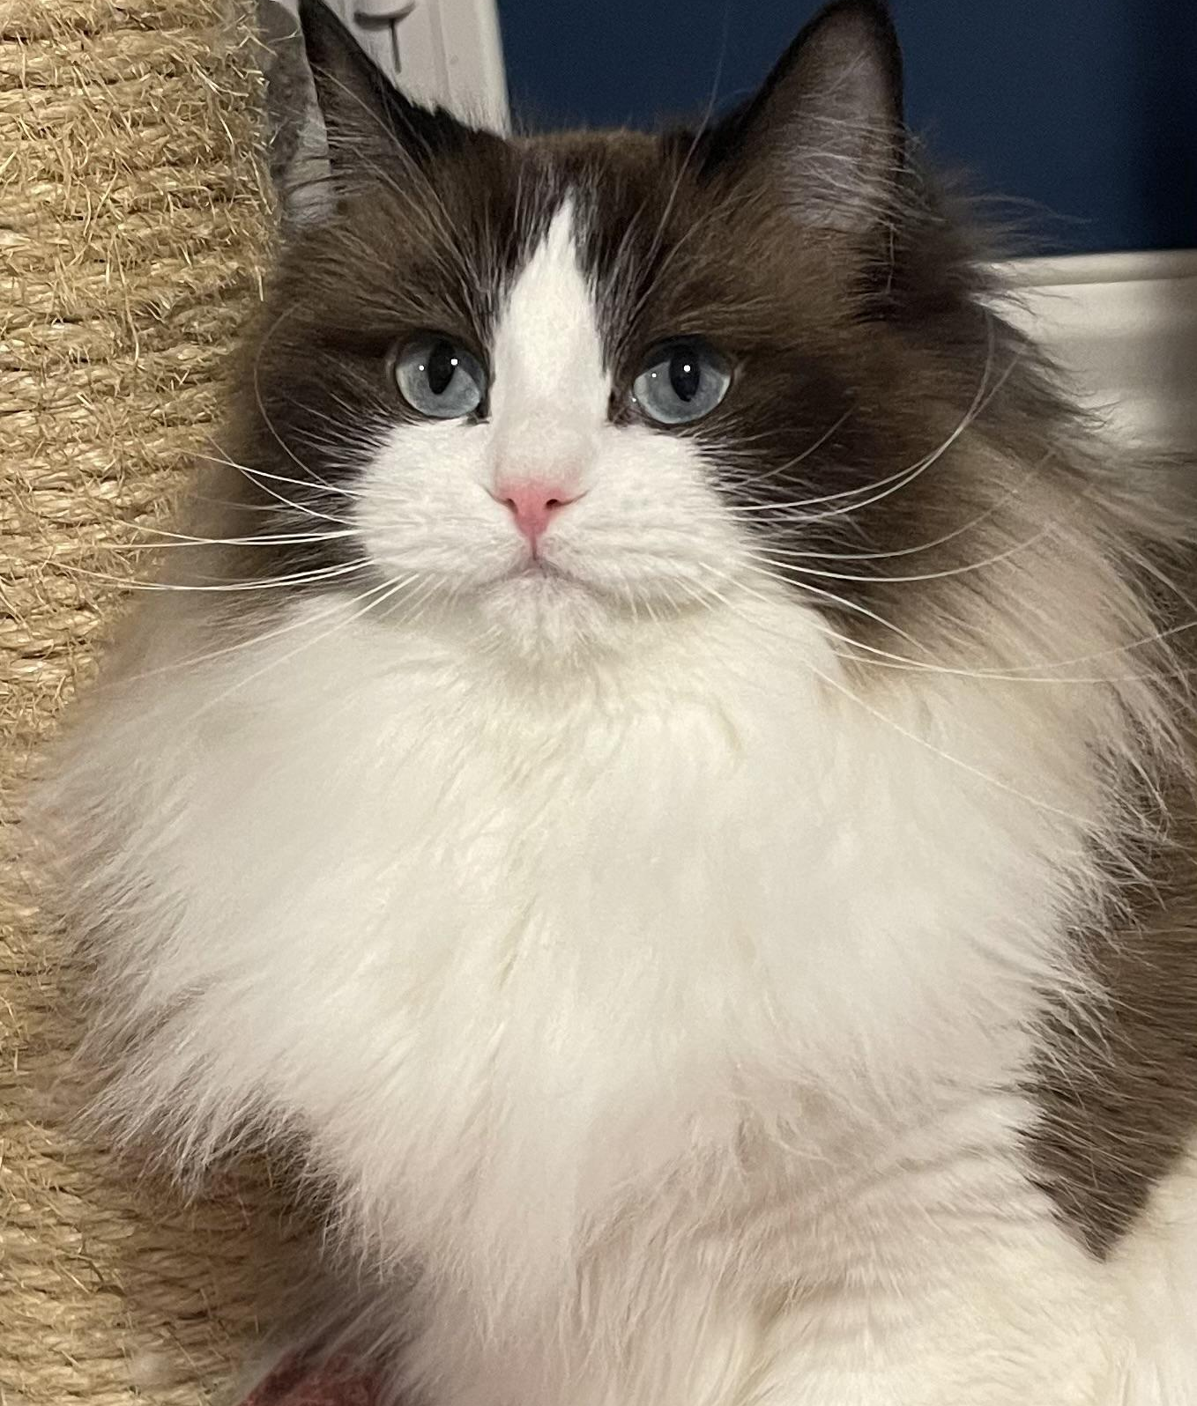
THE RAGDOLL BREED GROUP STANDARD (RD/CB)
The Ragdoll (RD) is a large semi longhair, blue eyed pointed cat of moderate type.
The Cherubim (CB) is a large semi-longhair, mink, sepia, or traditional colored cat of moderate type.
The breed standard outlines the aesthetic
ideal toward which breeders strive to achieve.
Point Breakdown in the Standard:
❖Head - 40
❖Body - 35
❖Coat/Color/Pattern - 25
100 points = 100%

Slide 21
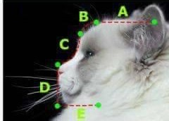
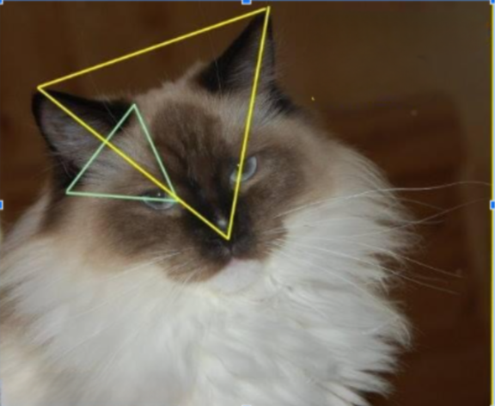
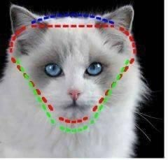
HEAD SHAPE PHOTOS (9 Points)
Broad modified wedge, with slightly rounded contours,
with the appearance of a flat plane in area between ears
when looking at the head from the front, skull medium in size.
.

Slide 22
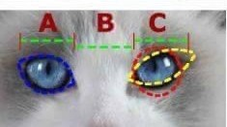
EYES (7 Points): Large oval. Moderately wide apart. Emphasis should be on correct shape, size, and placement–oval in shape, not round or slanted.

Slide 23
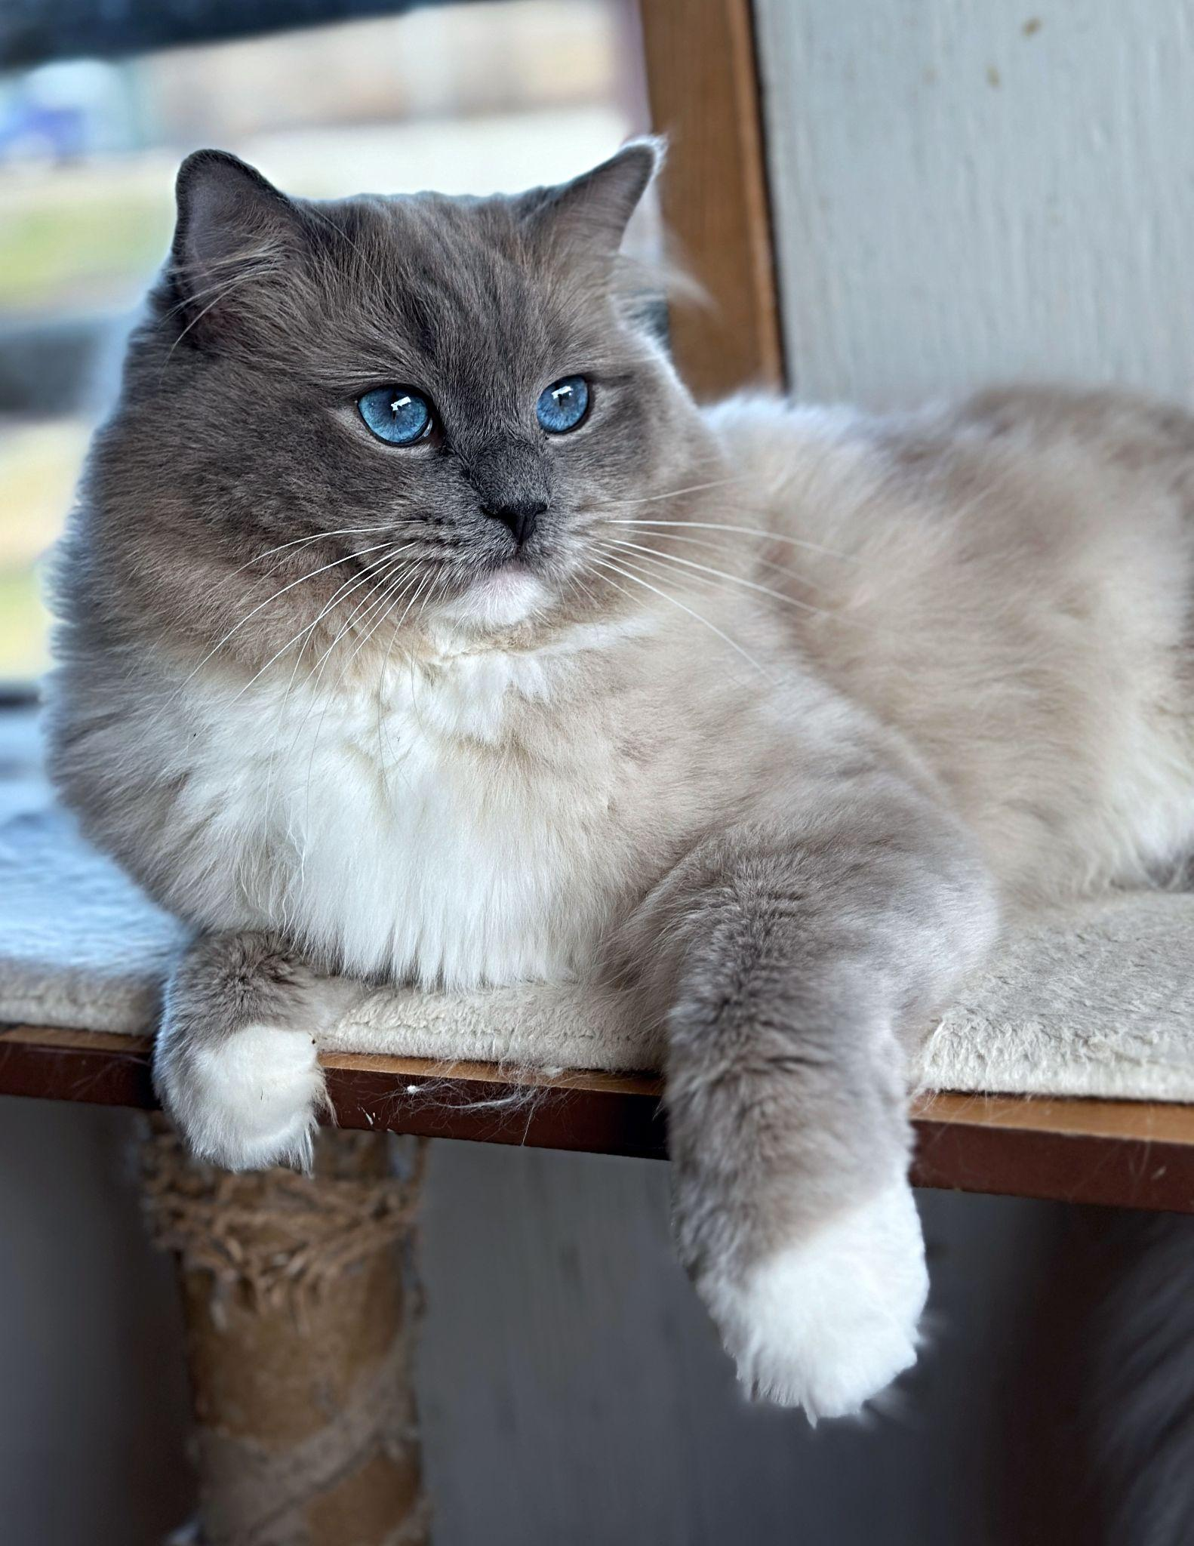
COLORPOINT GENE: PIGMENT RESTRICTING PATTERNS
The point gene is carried on the C locus, where pure albinism is also
carried. It is shown with the sign cs, and needs two alleles of cs for the
points to be expressed.
The pointed coat color pattern is recessive and is an error in the
production of Tyrosinase (TYR). The mutated enzyme is heat-sensitive;
it fails to work at normal body temperatures, but becomes active in
cooler areas of the skin. As a result, dark pigment is limited to the
coldest areas of the body, that is, the extremities.
Pointed kittens are born white, since the womb is uniformly warm. As
the kitten ages, the cooler areas darken while warmer areas remain
cream to white in color.
Points are not limited to solid colors or dark colors. It is possible to
have a red (orange color) or fawn (pale warm gray) point. It is also
possible to have a tortoiseshell or tabby point.
Mink, Sepia, and Solid Kittens are born with color, but Mink
Kittens carry the pointed gene (cs) so they also exhibit dark pigment
limited to the coldest areas of the body (cooler areas darken while
warmer areas remain lighter in color).

Slide 24
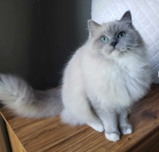
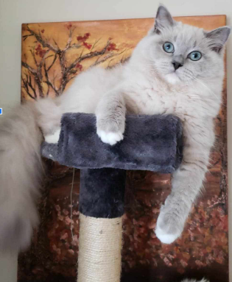
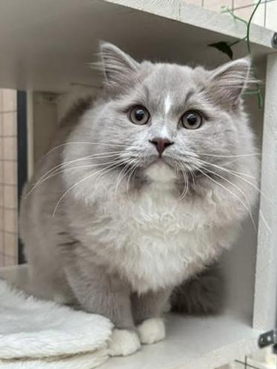
BREED STANDARD
COLOR/PATTERN
Solid Division
(CB) Mink: Even medium shade of body color showing
contrast to points. Allow for darker body in color in older
cats. Allow for underdeveloped color in kittens and young
cats.
(CB) Sepia: Body color closer to that of extremities, showing
slighter contrast to points. Allow for darker body color in
older cats. Allow for undeveloped color in kittens
and cats.
(CB) Traditional: Even solid color for solid colored
coats.

Slide 25
COAT TEXTURE
MINK Cherubim have a thicker, plusher coat than pointed Ragdolls with an extremely plush tail and heavy ruff around the neck. The coat of a mink is smoother and much softer than that of pointed Ragdolls and can be medium to long.
SEPIA Cherubim have the thickest, plushest, and most soft coat of all of the pointed Ragdolls.
TRADITIONAL (Solid) Cherubim have a sleeker, silken, and denser coat than the other Cherubim, of which falls smoothly due to the larger content of melanin in the hair shafts. The coat is medium long to long and does not mat.

Slide 26
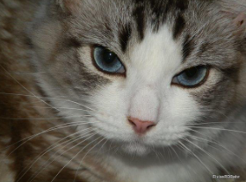
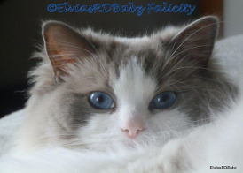
The Role of the Siamese (cs) Gene in the Ragdoll and Cherubim Cat Eye Color
Pointed Ragdoll cats, like the Solid
Cherubim cats, inherit the genes for producing a specific amount of
pigment, or melanin, in their eyes. Pointed Ragdolls and Mink Cherubim
carry the Siamese gene MUTATION, so they do not have enough pigment to
achieve green to the rich copper colored eyes of their TRADITIONAL
(solid) counterparts. The eyes of all Pointed (cscs) Ragdoll cats have only
tiny amounts of melanin, so their eyes are saturated with light
that cause them to appear blue instead of exhibiting coloration or
pigment. Their eyes, therefore, appear pale blue to deep cobalt
blue. Those with underlying green have the deepest blue;
whereas, underlying copper eyes with the most pigment produce
a whitish pale blue.
Seal Lynx Mink Bicolor:
Blue Point Bicolor:
—--->

Slide 27
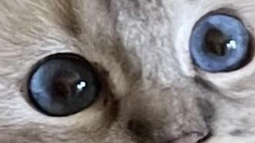
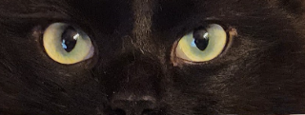
BREED STANDARD
EYES (7 Points) Preference given to deeper tones in all colors.
RD - Blue
CB - Mink: Blue-Green to Green-Blue (Aqua)
Sepia: Gold, Gold-Green (Chartreuse) or
Green.
Traditional: Bronze, Copper, Gold, Yellow,
Green, or Hazel.

Slide 28
EYE COLOR
According to Dr. Cris Bird’s article, “Siamese Eye Colors from Whitish Blue to Navy Blue,” and Lorraine M. Shelton, Et al., of Robinson’s Genetics for Cat Breeders and Veterinarians, cats with hidden copper genes will scatter more white light in their eyes. Their eyes will look very pale, whitish blue. Cats with hidden green genes will have very deep, dark blue eyes. Cats with the right mix of hidden genes for eye colors such as chartreuse, yellow, or gold will end up with blue eyes that are intermediate in color between whitish blue and navy blue.
“That green to copper spectrum of the domestic cat underlies the navy blue to whitish blue spectrum of the pointed cat. The same genes are behind both spectra...the Siamese mutation greatly reduces the amount of pigment produced in the eyes, allowing light to fill the eyes instead, and that shifts the eye color spectrum from green/copper to navy blue/whitish blue” (Bird 1).
The TICA Uniform Color Descriptions (UCD) might need to be updated to accommodate the mink and sepia Cherubim eye color that has been bred to attain the bluer hues as per the TICA Ragdoll Breed Standard.

Slide 29
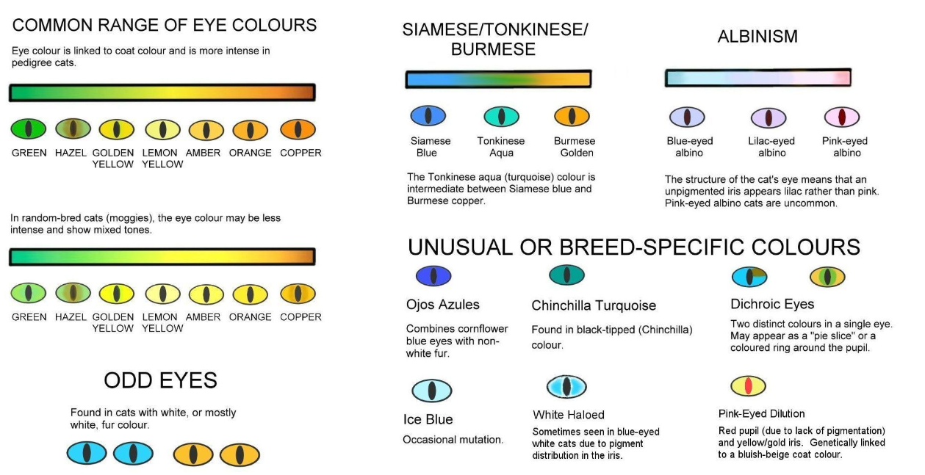
EYE COLOR CHART BY SARAH HEARTWELL

Slide 30
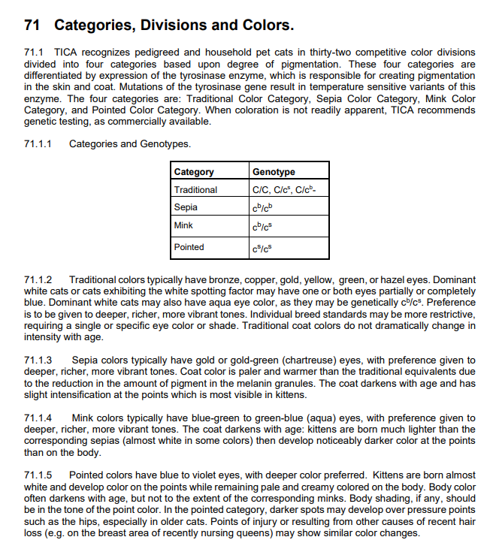
TICA
UNIFORM COLOR DESCRIPTIONS
(UCD)

Slide 31
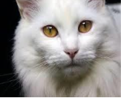
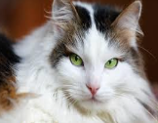
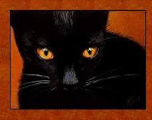
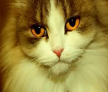
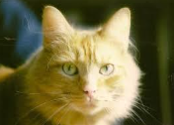
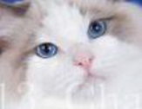
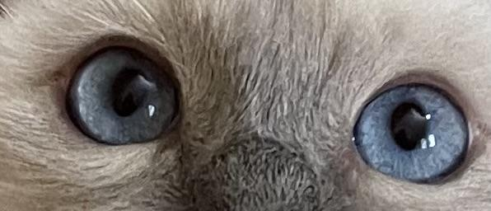
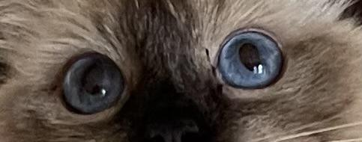
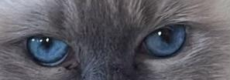
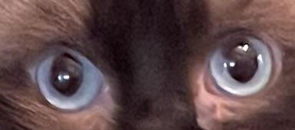
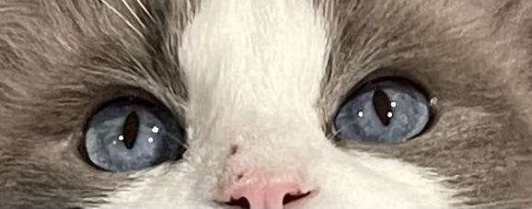
Blue (Pointed) Eye Spectrum
Bronze
Copper
Green
Gold
Yellow
Whitish blue
pale blue
light blue
blue
Dark blue

Slide 32
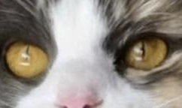
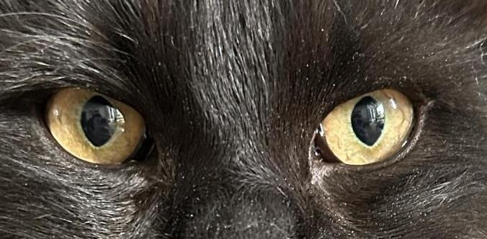
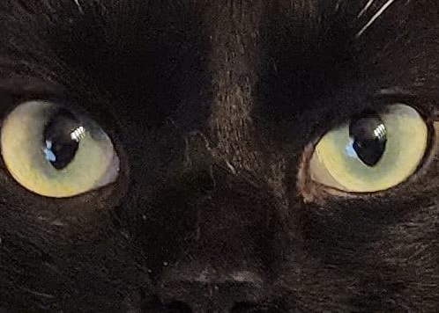
SOLID (Traditional) Eye Spectrum
Bronze
Copper
Green
Gold
Yellow

Slide 33
MINK Eye Spectrum
Green-blue (Aqua)
Blue-green

Slide 34
SEPIA Eye Spectrum
Gold
Chartreuse
Green
Gold-green

Slide 35
Pointed Ragdoll cats are produced by parents
carrying and passing on their Siamese colorpoint alleles of “cs.”
• A solid (Ccs) bred to a mink (cbcs) Cherubim will
produce 25% pointed kittens.
• Two mink Cherubim parents mated, a combination of cbcs, will
produce 25% pointed kittens.
• A pointed Ragdoll (cscs) cat bred to a mink (cbcs) Cherubim will
produce 50% pointed kittens.
• A solid (Ccs) Cherubim to a Pointed (cscs) Ragdoll will produce 50%
pointed kittens.
• If both Ragdoll parents are cscs, RECESSIVE BRED TO
RECESSIVE, then 100% of the kittens will be pointed.
• With only one, or no copies of this cs allele, the cat will have
pigmentation over the whole body and is considered a TRADITIONAL "solid"
colored cat (CC or Ccs)—without solid and mink,
the pointed Ragdoll WOULD NOT EXIST!

Slide 36
When a cat carries the genes cs and cb, the mink pattern is
formed, in which the pigment distribution is between a sepia
and a pointed cat.
Phenotypically, it is characterized by the same color dilution as with the cs gene.
However, there is not as profound a sensitivity to skin temperature and therefore the body coat color
is darker and much closer to that of the points.
An "additive" relationship exists between the cs and cb genes. What this means is
that when an animal is heterozygous for cs and cb (known as mink),
the coat color expression is halfway between that of a point (cscs) and a sepia (cbcb).
Technically, Mink and Sepia are pointed cats.
MINK CHERUBIM

Slide 38
SEPIA CHERUBIM
Also carried on the C locus, is the gene for the sepia pattern. This is
the darkest of all of the pigment restricting patterns, and pigment is
only paled at the warmest point in the body--the abdomen. This
pattern's gene is represented by cb.
The Burmese phenotype results from reduced pigment production
changing black pigment to sepia and orange to yellow. The Burmese
points are darker than the body.

Slide 40
SOLID CHERUBIM
A solid Ragdoll carries one of 3 genes for full color:
C/C: Full color, cat does not carry Burmese (sepia)
or Siamese alleles
C/cb: Carrier of Burmese (sepia) color
C/cs: Carrier of Siamese colorpoint restriction.

Slide 43
WORKS CITED
Bird, Cris Dr.. “Siamese Eye Colors from Whitish Blue to Navy Blue.” Journal of the Old Style Siamese. Newsletter of Preossia. https://www.oldstylesiamese.com/siameye1.html 2001-2022. PREOSSIA.
Hartwell, Sarah. "Eye Colors in Cats." 2009. http://messybeast.com/eye- colours.htm
Ishida Y, David VA, Eizirik E, Schäffer AA, Neelam BA, Roelke ME, Hannah SS,O'brien SJ, Menotti-Raymond M. 2006. A homozygous
single-base deletion in MLPH causes the dilute coat color phenotype in the domestic cat. Genomics
88:698-705.
Lyons, L.A., Imes, D.L., Rah, H.C. and Grahn, R.A. 2005. Tyrosinase mutations associated with Siamese and Burmese patterns in the domestic cat (Felis
catus). Animal Genetics, 36:119-126. See additional references cited in this paper.
Pearce, Wain. "Ragdoll History--Early Years."http://ragdollhistoricalsociety.org 2011-2015 Ragdoll Historical Society (RHS).
15 August 2015.
Peter Schmitt, M., Grain, F., Arnaud, B., Deleage, G. & Lambert, V.. Mutation in the melanocortin 1 receptor is associated with amber colour in the
Norwegian Forest Cat. Animal Genetics doi:10.1111/j.1365-2052.2009/01864.x
Robinson's Genetics for Cat Breeders and Veterinarians. 1999. Fourth edition. Eds. Vells, C.M., Shelton, L.M., McGonagle, J.J. and Stanglein, T.W.
Butterworth-Heinemann, Oxford.
Rollins, Tina. Original Ragdoll Genuine and Authentic: The Authentic Ragdoll by A. Baker – The Category Cherubim. Contributors: Lissy Uhe and Christiane Johannemann Lind. 2022. Books on Demand, Norderstedt.
Wallace, Lorna; Pickering, Robin, and Pollard, David. The Definitive Guide to Ragdolls. Ragdoll World. 1995 at Pontefract, West Yorks. England.
http://ragdollstexas.com/Welcome.html#dilution

